Slide 1
ARRAYS IN C++

Slide 2
Elementary Data Representation
Elementary representation of data can be in forms of :-
  Raw Data
  (These are simply values or set of values.
  Data Items
  (These represents single unit of values of certain type i.e. (data –type)
  Data Structure
  A data structure is a named group of data of different data types which can be processed as a single unit. It has well defined operations andd properties.

Slide 3
What is Data-type?
Data type refers to the normal group of data which share similar properties or characteristics.
Example:-
int : (0-9) , +,- sign
float : can store decimal values
character: (0-9) , (a-z) , (A-Z), special symbols

Slide 4
Data types in C++
Primitive data types
Non- Primitive data types

Slide 5
Primitive data types
These are data types which are composed of any other data types. Also referred to as standard or fundamental data types.
Ex: int , float , char, double

Slide 6
Non- Primitive data types
Those data types which are composed of primitive data types. Since, these are defined by the users , they are also referred to as user-defined data types.
Examples:
array , structure , class , union

Slide 7
Data Structure in C++
Simple Data Structure
Compound Data Structure

Slide 8
Simple Data Structure
These data structures are normally built from primitive data types such as int, char, foat etc.
Example:
Arrays
Structure

Slide 9
Compound Data Structure
Simple data structures can be combined in various ways to form more complex structures called compound data structures.

Slide 10
Types of Compound Data Structures
Linear Data structures:-
It is said to be linear if its elements forms a sequence.
Example:
Stack
Queue
Linked List

Slide 11
Non- Linear Data structures
These are multilevel data structures.
Example:
Tree

Slide 12
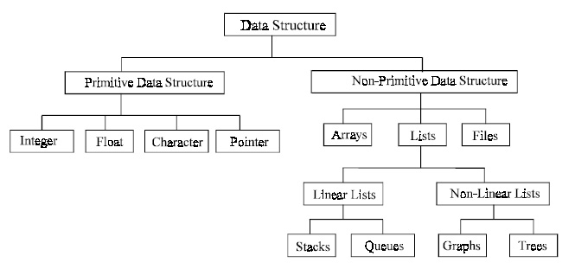

Slide 13
1. Arrays
Arrays refer to a named list of a finite number n of similar data elements.
Each of the data elements can be referenced separately by a set of consecutive numbers, 0,1,2,3……n
Arrays can be one-dimensional , two dimensional or multi dimensional

Slide 14
2. Structures
Structures refers to a named collection of variables of different data types.
The elements of a structure are referenced using the dot operator.
struct game
{
int gno;
char gname[25];
char type;
}g1;
g1.gno=100;
strcpy(“Need for Speed”,g1.gname);
g1.type=‘U’;

Slide 15
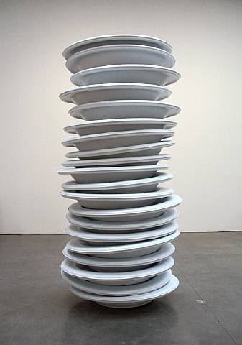
3. Stacks
Stack data structure refer to the lists stored an accessed in a special way, where LIFO (Last in First Out) technique is used.
In stacks, insertion and deletion of data items takes place only at one end, called the top.

Slide 16

4. Queues
Queues data structures are FIFO(First in First out), where insertion takes place at the rear end, and deletions takes place at the front end.
Queues is much the same as line of people waiting for their turn to buy tickets.

Slide 17
Operations on Data Structures
Insertion.
(means insertion of an element into an data structure)
Deletion
(means removal of a data element from an data structure. The item to be deleted must be searched first.)
Searching
(means searching of an data element in an data structure.)
Contd….

Slide 18
Traversal
(means processing all the data elements of it.)
Sorting
(means to arrange data elements of a data structure in an sorted(↑/↓) order.)
Merging
(means to combine elements of two similar data structures to form a new data structure of same type.)

Slide 19
Searching in arrays
Linear Search
In linear search, each element of the array is compared with the given item to be searched for, one by one.
This method of searching is also known as sequential search.
This technique will prove the worst, if the element to be searched is one of the last elements of the array, as so many comparisons would take place and the entire process would be time consuming.

Slide 20
Coding for Linear Searching
int lsearch(int[],int,int);
int main()
{
int i,ar[50],item,n,index;
cout<<"Enter desired array size\n";
cin>>n;
cout<<"Enter the array elements\n";
for(i=0;i<n;i++)
{
cin>>ar[i];
}
cout<<"Enter the element to be searched\n";
cin>>item;
index=lsearch(ar,n,item);
if(index==-1)
cout<<“Element could not be located in the array\n";
else
cout<<"Element "<<item<<"found at index "<<index<<"and at position"<<index+1;
}
int lsearch(int ar[],int n,int item)
{
for(int i=0;i<n;i++)
{
if(ar[i]==item)
return i;
}
return -1;
}

Slide 21
Efficiency of the Linear Search
The advantage is its simplicity.
  It is easy to understand
  Easy to implement
  Does not require the array to be in order
The disadvantage is its inefficiency
  If there are 20,000 items in the array and what you are looking for is in the 19,999th element, you need to search through the entire list.

Slide 22
Binary Search
Binary search algorithm is applicable for already sorted array only.
In this algorithm, to search for the given item from the sorted array (in ascending order), the item is compared with the middle element of the array. If the middle element is equal to the item then index of the middle element is returned, otherwise, if item is less than the middle item then the item is present in first half segment of the array (i.e. between 0 to middle-1), so the next iteration will continue for first half only.
If the item is larger than the middle element then the item is present in second half of the array (i.e. between middle+1 to size-1), so the next iteration will continue for second half segment of the array only.
The same process continues until either the item is found (search successful) or the segment is reduced to the single element and still the item is not found (search unsuccessful).

Slide 23
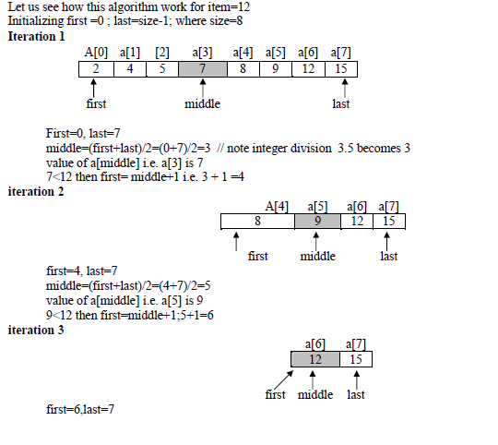

Slide 24
middle=(first+last)/2 = (6+7)/2=6
value of a[middle] i.e. a[6] is 12 which is equal to the value of item being search i.e.12
As a successful search the function binary_search() will return to the main function with value 6 as index of 12 in the given array. In main function p hold the return index number.

Slide 25
Binary Search
array
10
12
14
21
23
28
31
37
42
44
0
7
8
9
0
1
2
3
4
5
6
Let’s search for the position of the value 42 i.e. SV=42
3 variables are use for the same purpose low , high , mid
low stores the index of the first element of the array i.e. low=0
high stores the index of the last element of the array i.e. high=9
Mid=(low+high)/2
Mid=(0+9)/2 =4.5 =4
Now, array[mid] i.e. array[4] i.e. 23
Compare SV with array[mid]
If SV>array[mid] then low=mid+1 and if SV<array[mid] then high=mid-1
Now, since 42>23 , then low=mid+1 i.e. low=4+1 i.e. low=5 and high=9
28
31
37
42
44
5
6
7
8
9

Slide 26
Now low=5 , high=9 and mid=7
So array[mid]= array[7]=37
Again , Compare SV with array[mid]
i.e. 42>37 i.e. low=mid+1
Now low=8 ,high=9 and mid=8
Again , Compare SV with array[mid]
i.e. they are same
This means, 42 is located at index 8

Slide 27
Coding for Binary Search
int bsearch(int[],int,int);
int main()
{
int i,ar[50],item,n,index;
cout<<"Enter desired array size\n";
cin>>n;
cout<<"Enter the array elements\n";
for(i=0;i<n;i++)
{
cin>>ar[i];
}
cout<<"Enter the element to be searched\n";
cin>>item;
index=bsearch(ar,n,item);
if(index==-1)
cout<<"The given element could not be located in the array\n";
else
cout<<"Element "<<item<<"found at index "<<index<<"and at position"<<index+1;
}
int bsearch(int ar[],int n,int item)
{
int low=0,high=n-1,mid;
while(low<=high)
{
mid=(low+high)/2;
if(item==ar[mid])
return mid;
else if(item>ar[mid])
low=mid+1;
else
high=mid-1;
}
return -1;
}

Slide 28
Inserting elements in an array
We can insert elements in an array in two ways:-
If the array is not sorted, the new element is inserted at the end of the array.
If the array is sorted then the new element is added at appropriate position without altering the order.

Slide 29
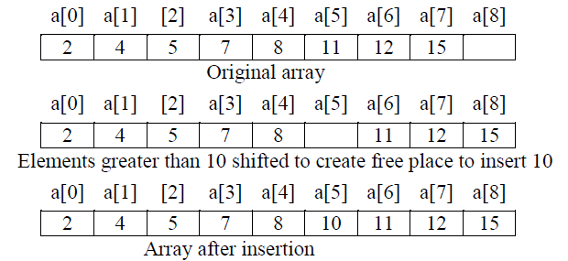
To achieve this, all elements greater than the new element are shifted. For example, to add
10 in the given array below:

Slide 30
Coding for insertion in an array
int FindPos(int [ ], int, int);
int main()
{
int ar[50],item,n,i,index;
cout<<"Enter desired array size (max 50)";
cin>>n;
cout<<"Enter array elements ";
for(int i=0; i<n;i++)
cin>>ar[i];
cout<<"Enter the element to be inserted";
cin>>item;
index=FindPos(ar,n,item);
for(i=n;i>index;i--)
ar[i]=ar[i-1];
ar[index]=item;
n+=1;
for(i=0;i<n;i++)
cout<<ar[i]<<" ";
}
int FindPos(int ar[], int size, int item)
{
int pos,i;
if(item<ar[0])
pos=0;
else
{kk
for(i=0;i<size-1;i++)
{
if(ar[i]<=item && item<ar[i+1])
{
pos=i+1;
break;
}
}
if(i==size-1)
pos=size;
}
return pos;
}

Slide 31
Deleting elements from an array
In this algorithm the item to be deleted from the sorted array is searched.
If the item is found in the array then the element is removed and the rest of the elements are shifted one position toward left in the array to keep the ordered array undisturbed.

Slide 33
Coding for deletion from an array
int lsearch(int [ ], int, int);
int main()
{
int ar[50],item,n,i,index;
cout<<"Enter desired array size (max 50)";
cin>>n;
cout<<"Enter array elements (sorted in asc order)";
for(int i=0; i<n;i++)
cin>>ar[i];
cout<<"Enter the element to be deleted";
cin>>item;
index=lsearch(ar,n,item);
if(index!=-1)
ar[index]=0;
else
cout<<"Element not found\n";
cout<<"Zero signifies deleted element\n";
for(i=0;i<n;i++)
cout<<ar[i]<<" “;
for(i=index;i<n;i++)
{
ar[i]=ar[i+1];
}
n=n-1;
cout<<"Array elements after deletion\n";
for(i=0;i<n;i++)
cout<<ar[i]<<" ";
}
int lsearch(int ar[],int n,int item)
{
for(int i=0;i<n;i++)
{
if(ar[i]==item)
return i;
}
return -1;
}

Slide 34
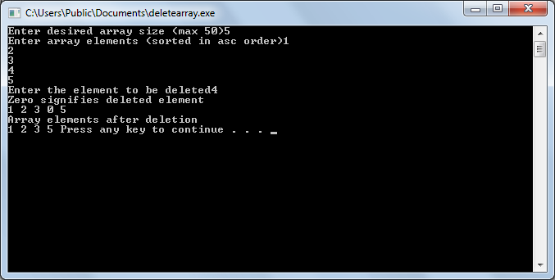

Slide 35
Traversal
Processing of all elements (i.e. from first element to the last element) present in one-dimensional array is called traversal.
For example, printing all elements of an array, finding sum of all elements present in an array.

Slide 36
What this program will do?
void print_array(int a[ ], int n)
{
int i;
cout<<"\n Given array is :\n";
for(i=0; i<n; i++)
cout<<a[i]<<", ";
}
int sum(int a[ ], int n)
{
int i,s=0;
for(i=0; i<n; i++)
s=s+a[i];
return s;
}
int main()
{
int b[10]={3,5,6,2,8,4,1,12,25,13},n=10;
int i, s;
print_array(b,n);
s=sum(b,n);
cout<<"\n Sum of all elements of the given array is : "<<s;
}

Slide 37
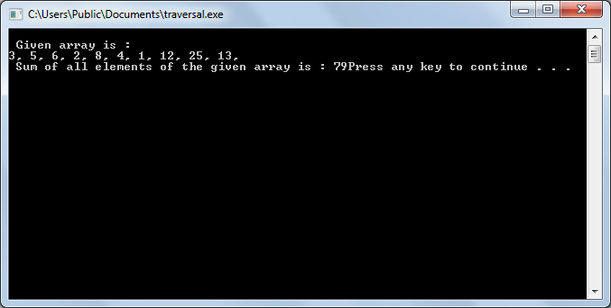

Slide 38
SORTING
The process of arranging the array elements in increasing (ascending) or decreasing (descending) order is known as sorting.
There are several sorting techniques available e.g. selection sort, insertion sort, bubble sort, quick sort, heap sort etc.
But in CBSE syllabus only selection sort, insertion sort, bubble sort are specified.

Slide 39
SELECTION SORTING
The basic idea of a selection sort is to repeatedly select the smallest element in the remaining unsorted array and exchange the selected smallest element with the first element of the unsorted array

Slide 41
Coding for Selection Sorting
void selsort(int ar[],int size)
{
int i,j,sm,pos,tmp;
for(i=0;i<size;i++)
{
sm=ar[i];
for(j=i+1;j<size;j++)
{
if(ar[j]<sm)
{
sm=ar[j];
pos=j;
}
}
tmp=ar[i];
ar[i]=ar[pos];
ar[pos]=tmp;
cout<<"Array after iteration "<<i+1 <<" is:";
for(j=0;j<size;j++)
cout<<ar[j]<<" ";
cout<<endl;
}
}
void selsort(int [],int);
int main()
{
int i,ar[50],n;
cout<<"Enter the array size\n";
cin>>n;
cout<<"Enter the array elements\n";
for(i=0;i<n;i++)
cin>>ar[i];
selsort(ar,n);
cout<<"The sorted array is shown below\n";
for(i=0;i<n;i++)
cout<<ar[i]<<" ";
cout<<endl;
}

Slide 42
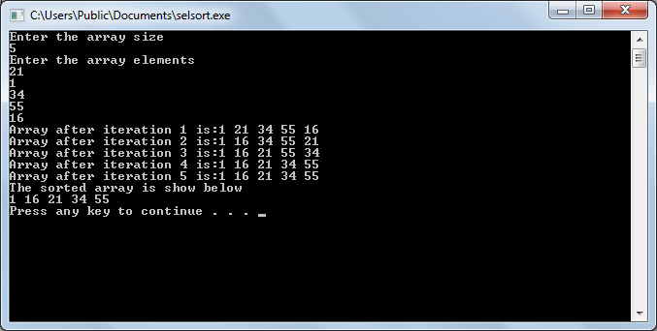

Slide 43
Bubble Sorting
Bubble sort compares a[i] with a[i+1] for all i=0..n-2, if a[i] and a[i+1] are not in ascending order then exchange a[i] with a[i+1] immediately.
After each iteration all elements which are not at their proper position move at least one position towards their right place in the array.
The process continues until all elements get their proper place in the array (i.e. algorithm terminates if no exchange occurs in the last iteration)

Slide 45
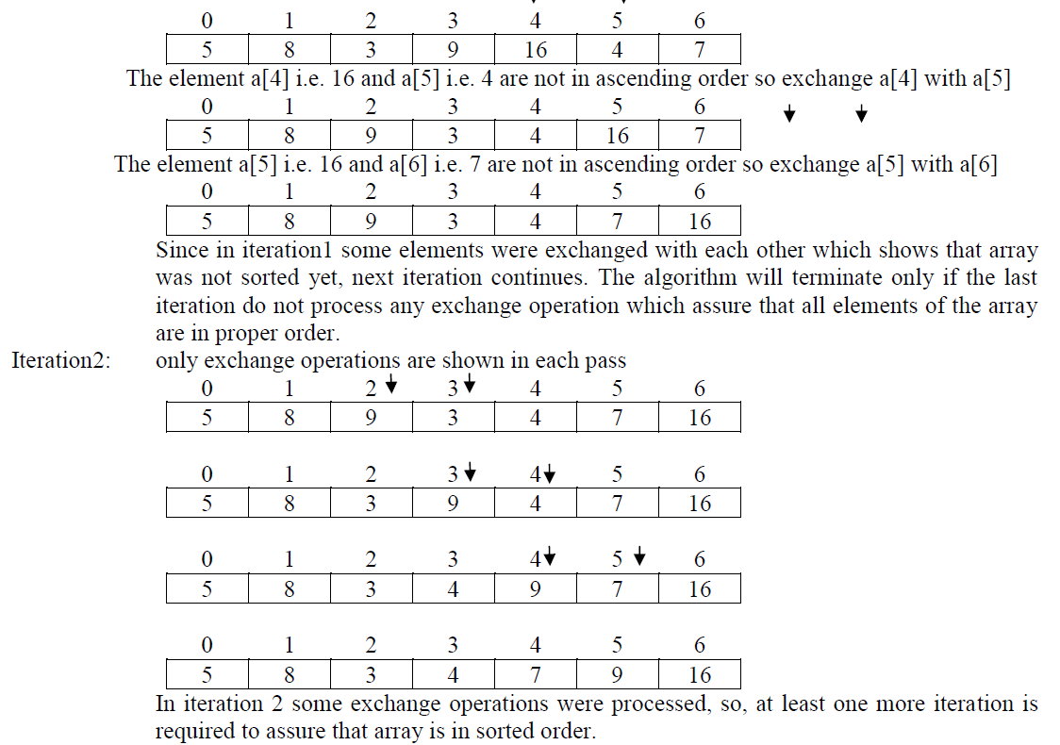

Slide 47
In every iteration, the heaviest element settles as its appropriate position in the bottom.

Slide 48
Coding for Bubble Sort
int main()
{
void bubblesort(int [],int);
int i,ar[50],n;
cout<<"Enter the array size\n";
cin>>n;
cout<<"Enter the array elements\n";
for(i=0;i<n;i++)
cin>>ar[i];
bubblesort(ar,n);
cout<<"The sorted array is \n";
for(i=0;i<n;i++)
cout<<ar[i]<<" ";
cout<<endl;
}
void bubblesort(int ar[],int size)
{
int i,j,tmp,ctr=0;
for(i=0;i<size;i++)
{
for(j=0;j<(size-1)-i;j++)
{
if(ar[j]>ar[j+1])
{
tmp=ar[j];
ar[j]=ar[j+1];
ar[j+1]=tmp;
}
}
cout<<"Array after iteration "<<i+1 <<" is:";
for(int y=0;y<size;y++)
cout<<ar[y]<<" ";
cout<<endl;
}
}

Slide 49
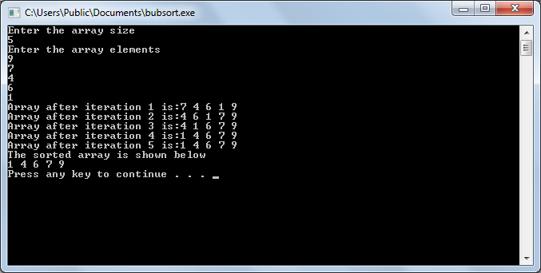

Slide 50
Insertion Sorting
An insertion sort is one that sorts a set of values by inserting values into an existing sorted file.

Slide 51
To illustrate the insertion sort method, consider the following array with 7 elements. 25,15,30,9,99,20,26 Array a of 7 elements
25 | 15 | 30 | 9 | 99 | 20 | 26
0 | 1 | 2 | 3 | 4 | 5 | 6
Pass-1: a[1]<a[0], interchanging the position of elements , we get
15 | 25 | 30 | 9 | 99 | 20 | 26
0 | 1 | 2 | 3 | 4 | 5 | 6
Pass-2 a[2]>a[1] , position of elements remains same.
15 | 25 | 30 | 9 | 99 | 20 | 26
0 | 1 | 2 | 3 | 4 | 5 | 6

Slide 52
Pass-3 a[3] is less than a[0], a[1] and a[2] , so insert a[3] to a[0] place
and shift a[1], a[2] and a[3]
9 | 15 | 25 | 30 | 99 | 20 | 26
0 | 1 | 2 | 3 | 4 | 5 | 6
Pass-4 a[4]> a[3], No change performed
9 | 15 | 25 | 30 | 99 | 20 | 26
0 | 1 | 2 | 3 | 4 | 5 | 6
Pass-5 Now a[5] is less than a[2] a[3] and a[4] ,
so move a[5] before a[2]
9 | 15 | 20 | 25 | 30 | 99 | 26
0 | 1 | 2 | 3 | 4 | 5 | 6

Slide 53
Pass-6 Now a[6] is less than a[4] and a[5] , so move a[6] before a[4]
9 | 15 | 20 | 25 | 26 | 30 | 99
0 | 1 | 2 | 3 | 4 | 5 | 6
After pass VI, we get array with sorted elements

Slide 54
Coding for Insertion Sort
for(k=1;k<=n-1;k++)
{
temp=a[k];
j=k-1;
while(temp<a[j] && (j>=0))
{
a[j+1]=a[j];
j=j-1;
}
a[j+1]=temp;
}
cout<<"The sorted elements are"<<endl;
for(i=0;i<n;i++)
{
cout<<a[i]<<" ";
}
}
int main()
{
int a[100],n,k,j,i,temp;
cout<<"Enter the number of elements";
cin>>n;
cout<<"Enter the array elements";
for(i=0;i<n;i++)
cin>>a[i];

Slide 55
2-D Arrays
A two-dimensional array is an array in which there are two subscripts i.e. 1st subscript for the row and 2nd subscript for the column.
For example: int x[3][4];
has 12 elements
i.e multiplying row x column

Slide 56
Another way of representing an 2-d array
int a[-2..5 , -1..3]
where
-2 is the lower bound for row
5 is the upper bound for row
-1 is the lower bound for column
3 is the upper bound for column
Now no. of rows can be calculated as
UB-LB+1
i.e. 5-(-2)+1 = 8
&No. of columns can be calculated as
UB-LB+1
i.e. 3-(-1)+1 = 5
So, the total no. of elements in the above mentioned array will be R X C i.e. 8 x 5 =40

Slide 57
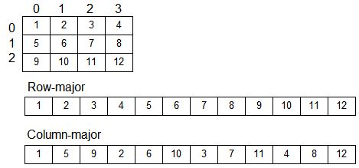
Row Major Form and Column Form

Slide 58
Row major form
The formula for address calculation (in Row major order) of element [I,J] in an array of mxn elements with base address B and element size W bytes is given below.
Address[I,J]=B+W[n(I-1)+(J-1)]

Slide 59
More generalised form of the formula in row major form
If the array is A[Lr..Ur,Lc..Uc]
Address of [I,J] element is
B+W[n(I-Lr)+(J-Lc)]
n=no. of columns
n=Uc-Lc+1

Slide 60
Column major
Address of element [I,J]=
B+W[m(J-Lc)+(I-Lr)]
m=no. of rows
m=Ur-Lr+1

Slide 61
Each element of an array A[-20..20,10..35] requires one byte of storage. If the array is stored in column major order with beginning location 500, determine the location of A[0,30]
B+W[m(J-Lc)+(I-Lr)]
B=500 W=1 m=20-(-20)+1 =41
Lr=-20 Ur=20 Lc=10 Uc=35
I=0 J=30
500+1[41(30-10)+(0-(-20)]
500+(41x20+20)
500+840
1340.

Slide 62
Problem with different pattern
An array Arr[40,10] is stored in the memory along the column with each element occupying 4 bytes. Find out the address of the location Arr[3,6] if he location Arr[30,10] is stored at address 9000.

Slide 63
Given values
Arr[40,10] i.e. m=40 and n=10
W=4, I=3, J=6
Address of Arr[30,10]=9000
Base address (B)=?
Lowest row Lr=0 and Lowest column Lc=0
Address of element [I,J]=B+W[m(J-Lc)+(I-Lr)]
Arr[30][10]=B+4[40(10-0)+(30-0)]
9000=B+4(430)
9000=B+1720
B=7280
Arr[3,6]= 7280+4[40(6-0)+(3-0)]
7280+4(243)
7280+972
8252

Slide 64
An array Arr[15,20] is stored in the memory along the row with each element occupying 4 bytes. Find out the base address and the address of the element Arr[3][2] if the element Arr[5,2] is stored at the address 1500.

Slide 65
Write a function in C++, which accepts an integer array and its size as parameters and rearranges the array in reverse order.
void revarray(int a[],int size)
{
int i=0,j=size-1,tmp;
for(i=0;i<=j;i++,j--)
{
tmp=a[i];
a[i]=a[j];
a[j]=tmp;
}
}

Slide 66
Write a function in C++, which accepts an integer array and its size as parameters and replaces elements having even values with its half and elements having odd values with twice its value.
void replace(int a[],int size)
{
for(int i=0;i<size;i++)
{
if(a[i]%2==0)
a[i]/=2;
else
a[i]*=2;
}

Slide 67
Write a function in C++ to print the product of each row of a 2-d integer array passed as an argumeent to the function.
For example if the array has
Product of Row-1=8000
Product of Row-2=6000
Product of Row-3=3600
Product of Row-4=2400
20 | 40 | 10
40 | 50 | 30
60 | 30 | 20
40 | 20 | 30

Slide 68
void rowproduct(int a[][],int r,int c)
{
int prod[r],i,j;
for(i=0;i<r;i++)
{
prod[i]=1;
for(j=0;j<c;j++)
prod[i]*=a[i][j];
cout<<“Product of Row”<<i+1<<prod[i]<<“\n”;
}
}

Slide 69

Write a function in C++, which accepts an integer array and its size as arguments and assign the elements into an 2d array of integers as follows:-
If the original array is {1,2,3,4,5,6} then the resultant 2D array will be
1 | 2 | 3 | 4 | 5 | 6
1 | 2 | 3 | 4 | 5 | 0
1 | 2 | 3 | 4 | 0 | 0
1 | 2 | 3 | 0 | 0 | 0
1 | 2 | 0 | 0 | 0 | 0
1 | 0 | 0 | 0 | 0 | 0

Slide 70
void func(int a1[],int size)
{
int a2[20][20],i,j;
for(i=0;i<size;i++)
{
for(j=0;j<size;j++)
{
if(i+j)>=size)
a2[i][j]=0;
else
a2[i][j]=a1[j];
cout<<ar[i][j];
}
cout<<endl;
}
}

Slide 71
Do it yourself….

Slide 72
Write a function alternate(int a[][3],int n,int m) in C++ to display all alternate elements from two dimensional array A (starting from A[0][0].

Slide 73
int main()
{
int a[3][3]={90,56,45,20,34,54,33,44,77};
int i,j,tmp;
for(i=0;i<3;i++)
{
for(j=0;j<3;j++)
{
if((i+j)%2==0)
cout<<a[i][j]<<" ";
}
}
}

Slide 74
Write a function swap2best(int ar[],int size) in C++ to modify the content of the array in such a way , that the elements which are multiples of 10 swap with the value present in the very next position in the array.
For Example:
If the contents of array ar is
90 , 56 , 45 , 20 , 34 , 54
Then content of array will become
56 , 90 , 45 , 34 , 20 , 54

